Slide 1
Beyond Housing
Financial Performance 28 September 2025 Unaudited Figures

Slide 2





Financial performance I&E 2025/26
 | Actual Sept 2025 | Budget Sept 2025 | Variance to budget | Fav/un fav
 | £m | £m | £m
Turnover | 48.207 | 51.716 | 3.509
Operating Costs | 41.701 | 44.164 | 2.463
Operating Surplus | 6.506 | 7.552 | 1.046
Net Interest Payable | 4.064 | 4.136 | 0.072
Corporation Tax | 0.015 | 0.000 | 0.015
Net Surplus before transfer to reserves | 2.427 | 3.416 | 0.989
Turnover – lower units in management due to reprofiled development programmme, lower development sales and higher numbers of void properties against budget.
Operating costs – lower development sale costs and a surplus on the disposal of housing properties are partially offset by higher repairs and maintenance costs.
2

Slide 3


Financial performance B/S 2025/26
 | Actual Sept 2025 | Actual March 2025 | Movement | Fav/un fav
 | £m | £m | £m
Fixed Assets | 514.565 | 498.605 | 15.960
Current Assets | 25.829 | 26.286 | 0.457
Current Liabilities | 18.578 | 19.477 | 0.899
Total Assets less Current Liabilites | 521.816 | 505.414 | 16.402
Long term Labilities - loans | 276.630 | 264.220 | 12.410
Current Assets – lower levels of outright sales properties held
Fixed Assets – new development and investment in stock
3

Slide 4
Treasury framework
Board approved business plan sets ‘golden rules’ at tighter levels than lender covenants to ensure a buffer is sustained
Cash balance c£13.6m September 2025
Beyond Housing have in place a £250m ESG 30-year bond originally issued May 2021 at September 2024 £205m was drawn with £45m retained.
Moodys credit rating update at October 2025 is (A2 stable) in line with the previous annual review.
 | Golden rule | Performance (as at end September 2025)
EBITDA interest cover | 154% | 224%
Asset cover ratio | 126.5% | 156%
Net borrowing: Housing assets at cost | <63% | 48%
Cash and cash equivalents | To cover at least 21 months or requirements | 42 months
Current ratio | >1.0 | 1.4
Open market sales | <20% of turnover p.a. | 0.5%
4

Slide 5



Current facilities by lender
Beyond Housing debt September 2025 consists of loans from four lenders:
Royal Bank of Scotland (14% of the portfolio) Bond (59% of the portfolio)
Nationwide (19.5% of the portfolio)
£275m of the drawn debt, total facility debt £395m loan average life of 19.5 years
£75m of facility represents Revolving Credit Facility (RCF)
Undrawn facilities total £120m of which £75m is RCF, £45m bond.

Slide 6

Capital programme - Total jobs completed
£16.5m to be invested in 2025/26
Notes:
Caroline

Slide 7
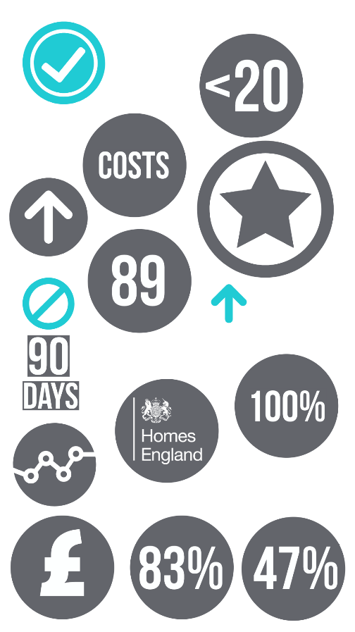
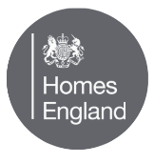


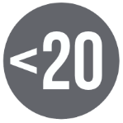

Development – performance monitoring
Customer satisfaction 83%
Planned model programme contractual starts 147 and completions 240
Committed programme cost and income variance (less than £200k from approved)
Financial performance – affordable five-year programme will achieve a cumulative NPV of over £16m
Less than 20 unsold sales homes
89 homes sold (shared ownership and rent to buy)
47% of programme low-cost home ownership (includes 4% rent to buy)
Notes:
Clare

Slide 8
Environmental strategy
Continuing to invest in a low regret (fabric first) programmes including loft insulation top ups, removing secondary heating and installing smart thermostatic radiator valves, smart thermostats and low energy light bulbs
86.2% of homes meet the Energy Performance Certificate (EPC) C target. Target is 100% before 2030
Business scoped emissions increased to 1,950 tCO2e in 2024/25 compared to 1,582 tCO2e in 2023/24. This was due to improved data collection resulting from proactive mechanisms in place to record usage. This position will form the new baseline for reporting moving forward.
EPC ratings of existing stock
EPC
A
B
C
D
E
F
NC
Stock total
01/04/2025
44
1146
11946
1873
97
9
124
15,239
Notes:
Caroline
New builds – schemes off gas (committed Ingleby Arncliffe and Kirkleatham supported living village),. In progress Kirkleatham Phase 3 and Summerville homes are all air source heat pumps for heating and hot water.

